Slide 1
Concurrent Versions System

Slide 2
Contents
Introduction
Why do people use CVS?
What do people use CVS for?
Logging into a CVS Repository
Importing Projects into CVS
Adding Directories into CVS
Adding Files into CVS
Checking out Files from CVS
Removing Files / Directories
Revision Numbers

Slide 3
Contents
Tagging Files in CVS
Branching and Merging
CVS Command Summary
References

Slide 4
Introduction
CVS is a version control system.
This is used to record the history of source files.
CVS stores all the versions of a file in a clever way that only stores the differences between versions.
CVS is also helpful for those who are part of a group working on the same project.

Slide 5
Why do people use CVS?
Allows multiple people to work independently on the same set of files.
Enables you to track who made what change when and why they made that change.
Provides central location for all source code.
Tracks the history of a project over time.
By its nature, creates redundant backups of code.

Slide 6
What do people use CVS for?
Basically any collection of files, including:
Software development
Documentation projects

Slide 7
The Repository
Repository is a directory storing the master copies of the files.
The CVS repository stores a complete copy of all the files and directories which are under version control.

Slide 8
Local CVS Repository
Set CVSROOT environment variable to the location of the CVS repository
$ CVSROOT=/tdcvsrep

Slide 9
Remote CVS Repository
When the repository is on another machine, it must be reached over the network.
$CVSROOT=:pserver:user@172.16.2.50:/home/cvs
$cvs login
Logging in to :pserver:user@172.16.2.50:2401/home/cvs
CVS password:*****

Slide 10
Creating a Repository
To create a repository,run the cvs init command
$cvs -d /usr/local/cvs init

Slide 11
Importing Projects into CVS
Putting a new project into CVS repository is known as importing
Once you have access to a repository, you need to import one or more modules for people to use.
cd into directory containing files to be imported.
Entire directory tree will be imported into CVS.

Slide 12
Importing Projects into CVS
$ cd dir
$ cvs import -m “Import Success” DIR dir start

Slide 13
Checking out files from CVS
To check out files from the repository use cvs checkout command.
$ cvs checkout ProjectX

Slide 14
Adding Directories to CVS
To add a directory run the add command.
cvs add <directory name>
$ cd Project
$ mkdir test
$ cvs add test

Slide 15
Adding Files to CVS
Adding a file is a two-step process: First run the add command on it, then run commit.
The file will not actually appear in the repository until commit is run.
cvs add <file name(s)>
$ cd test
$ touch a.txt
$ touch b.txt
$ touch c.txt
$ cvs add *.txt
$ cvs commit –m “Added new Files”

Slide 16
Removing Files / Directories
Make sure that no uncommitted modifications are done to the file.
Remove the file from your working copy of the directory. Use rm.
Use cvs remove filename to tell cvsnt that you really want to delete the file.
Use cvs commit filename to actually perform the removal of the file from the repository.

Slide 17
Revision Numbers
Each version of a file has a unique "revision number".
By default, CVS will assign numeric revisions by leaving the first number the same and incrementing the second number. For example,`1.1', `1.2', `1.3', etc
To set the numeric revisions, use the `-r' option to `cvs commit'
Note that the number you specify with `-r' must be larger than any existing revision number.
$ cvs commit

Slide 18
Tagging Files in CVS
Use the `tag' command to give a symbolic name to a certain revision of a file.
Use the `-v' flag to the `status' command to see all tags that a file has, and which revision numbers they represent.
Tag names must start with an upper case or lower case letter.
$ cvs tag rel-1-0-patches file.c

Slide 19
Branching and Merging
A CVS branch splits a project’s development into separate, parallel branches.
Changes made on one branch do not affect the other.

Slide 20
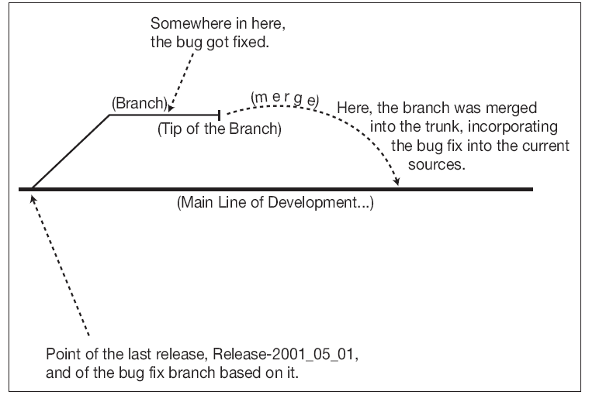
Branching and Merging

Slide 21
Branching and Merging
To create a branch use tag -b.
It is important to understand that branches get created in the repository, not in the working copy.
$ cvs tag -b -r rel-1-0-patches

Slide 22
Branching and Merging
To check out a branch from the repository, invoke checkout with the -r flag, followed by the tag name of the branch.
$ cvs checkout -r rel-1-0-patches tc
$ cvs status -v

Slide 23
Branching and Merging
To merge changes made on a branch into the working copy by giving the -j branch name flag to the update subcommand.
$ cvs update -j rel-1-2-patches rel-1-0
$ cvs commit -m "Merged the modified"

Slide 24
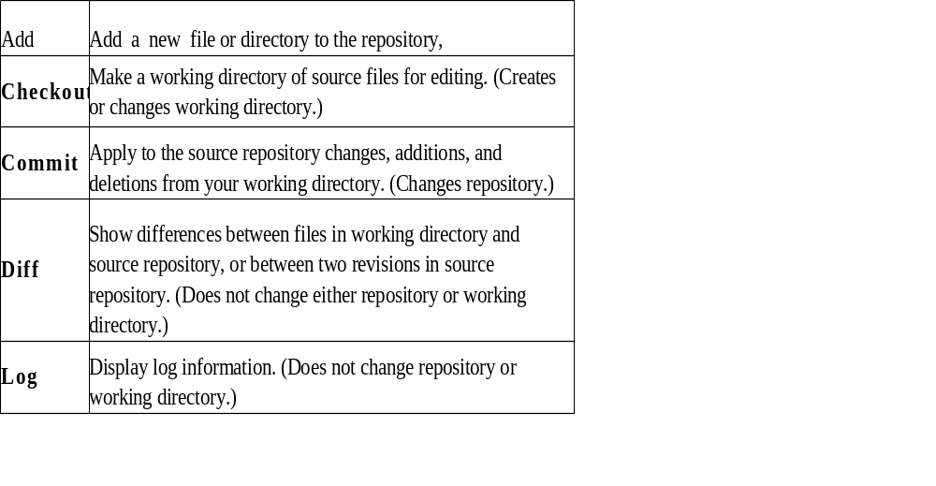
CVS Command Summary

Slide 25
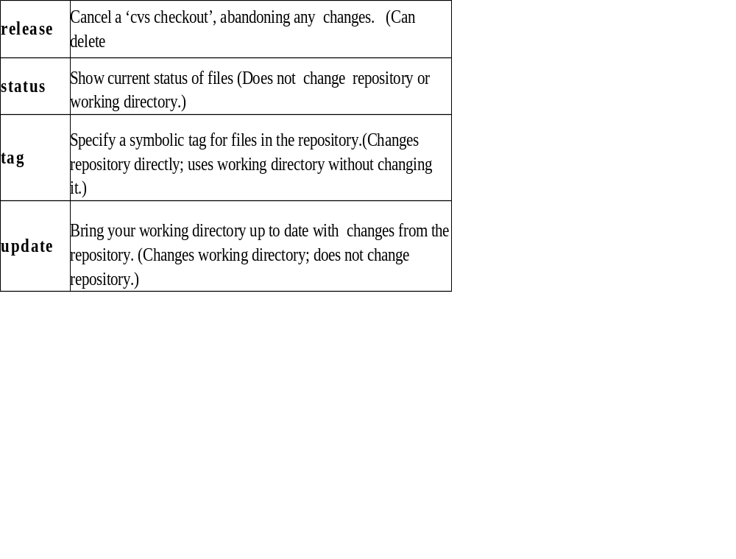
CVS Command Summary

Slide 26
Thank You

